Slide 1
Huron Rising 2.0
Summary Findings, Recommendations, and Next Steps

Slide 2
Our work tonight
Discuss the process taken to support Huron Rising 2.0
Highlight the most important findings and next steps
Develop potential measures to know if we are being successful
Introduce an accountability plan to get us to Huron Rising 3.0
Celebrate the community’s hard work

Slide 3
First, some thanks…
The Huron Rising 2.0 Committee
  Rhonda Kludt
  Ted Haeder
  Steve Gohn
  Heather Burns
  Rich Bragg
  Laurie Shelton
  Mary Pearson
  Bryan Smith
  David McGirr
Greater Huron Development Corporation
Huron Chamber & Visitors Bureau
Community Campus and Huron Parks and Recreation Dept
  Chad Schroeder and Team
Nearly 230 survey participants and 100+ group discussion participants
  You invested your time and passion. Thank you for helping shape Huron’s future.
  Huron’s young people for participating across the board!

Slide 4

Huron Rising 2.0: Huron in Five Years
Vibrant and appealing
A place young people want to live and grow their families
Attractive for people to return to
A destination for conferences and events
Growing, with more people in better-paying industries
A harmonious community that respects and celebrates differences
A community that values care for one another across generations
A city that emphasizes learning, upskilling, and self-sufficiency

Slide 5

What success of Huron 2.0 looks like
An understanding around priorities
A recognition of what has worked from Huron Rising 1.0 and a commitment to continuing that momentum
An honest assessment around where there are gaps in the community and how we can use Huron Rising 2.0 to fill or plan around those gaps
A series of “stub” plans to build upon over the next year
A measurement plan to know if we’re being successful by Year 5 and interim measures to know if we’re on the right path

Slide 6
Some Uncomfortable Truths
Not everything that everyone values will be a priority
We can’t boil an ocean
Some things won’t work and we have to celebrate rather than tear down failures
Money won’t solve much, but it can help if it’s invested wisely
It will be tempting to widen the scope of these findings. Don’t do it.

Slide 7

Some high-level recommendations
Lean into who you are as a community and be great at it.
Focus on community pride and find areas where you can enhance that first. That’s a flywheel that keeps producing for you.
Put a group in charge of measuring progress every year (and meeting quarterly to make sure you’re all on the same page).
Focus on what you can control. Public opinion and PR is one of those things.
Bleed efforts across the city, nonprofits, economic development organizations, and individuals.
Read the qualitative comments from the survey: they are honest and point to good suggestions and genuine experiences.

Slide 8
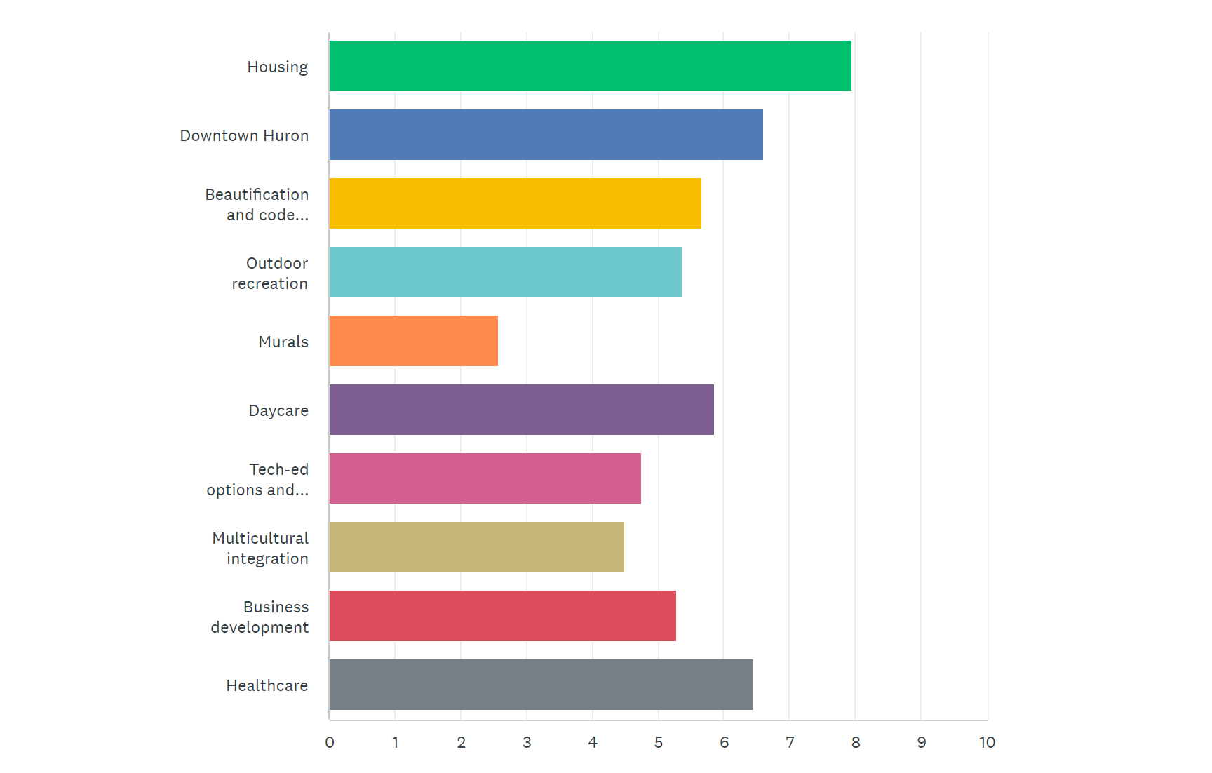
Survey Results: Our guide for last Tuesday

Slide 9
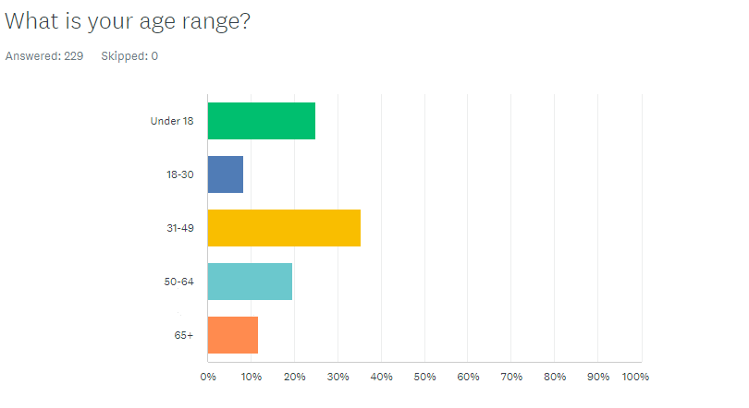
Survey Results: Age Demographics

Slide 10
Survey and Discussion Priority Areas
Housing and dilapidated properties
Downtown revitalization and streetscape
Trades education and housing/revitalization dependencies
Healthcare
Childcare
Continuing Education and supportive education
Community cultural awareness and integration

Slide 11
Housing Summary
Strengths: significant investment in the last five years, individual progress on small scale, proof of concept, new developments, lot affordability
Weaknesses: pace of property deterioration, expanded need for affordable housing, lack of tradespeople, cultural disconnects
Opportunities: enforcement, education, capital infusion, trades education

Slide 12
Housing Focus Next Steps
Expand developer incentives for lot prices, new developments, and related tax credits
Enhance enforcement warning, timeline, and penalty amounts; be faster to condemn, repossess, and transition homes and lots to new owners with improvement convenances
Build a homeowner improvement continuing education opportunity with graduation incentives (project, cost match, and validation through city inspection)
Encourage sales of existing properties/transition for older residents with rent or seller % offsets
Focus on trades education by starting and staffing (with incentives) CTE programs through the community campus and high school
Establish a trades “educate and return” program accompanied by a promise to serve in the trades in Huron (Build Dakota, but local)
Consider an equipment “lending library” to enable people without the means to have access to tools for improvement

Slide 13

Measuring Housing Progress
New single family home construction $ (increase per year controlling for inflation)
New multi-family home construction $ (increase per year, controlling for inflation)
Individual units rehabilitated via programmatic dollars
New permits for renovation and successful inspection
Property value increase (based on taxable value) post-renovation
Apartment and existing housing vacancies created
Change in city ordinance enforcement timelines and penalties and associated revenue/impact

Slide 14

Downtown & Streetscape Development Summary
Strengths: investment and evidence of improvement in the downtown area; planned state development on Dakota Avenue
Weaknesses: many storefronts still are in need of improvement; former seed warehouse on Dakota Ave N opportunity; vacant lots and eyesores
Opportunities: new business incentives; more infusion of investment/incentives to improve storefronts; nonprofit property acquisition and transfer incentives

Slide 15
Downtown Focus Next Steps
Envision downtown in 10 years, including storefront look, business mix, and dependencies to get there
Identify transitioning businesses and properties and stay ahead of those transitions to prevent vacancies and property upkeep issues
Survey the community about desired businesses and deliver on those businesses in forthcoming or currently vacant storefronts (via business credits, property tax credits, or property improvement funds)
Ensure downtown streetscape has a continuity plan that extends beyond 3rd and 9th and Dakota
Identify prospective apartment inventory in the downtown area through existing property improvements/renovations and accelerate affordable apartment inventory in the downtown corridor

Slide 16
Measuring Downtown Progress
Establishment of downtown vision committee and plan creation
Build list of available and “coming available” downtown properties to get ahead of vacancy and potential rehabilitation issues
Increased number of new building/business owners via generational transition or building acquisition/improvement incentives
Increased % of improved building facades
Increased number of available downtown and affordable apartments
Revenue increase among downtown businesses (via sales tax revenue)

Slide 17
Trades Education Dependency
The ability to improve and build homes and rehabilitate downtown at pace is limited not just by funding, but qualified and trusted professionals
Generational transition of businesses in HVAC, electrical, plumbing, and construction has pinched Huron on a variety of fronts
CTE and trade schools offer options, but Huron residents and students need incentives
Two issues: training new people at pace and generational transition happening with no backfill

Slide 18

Trades Education Next Steps
Conduct a provider inventory and identify shortfalls via current or 3-5 year business transition issues
1
Reserve funding and partner with the Governor’s office, STE, and the high school to establish “Build Huron” trades education and tuition/training incentives at CTE and HHS
2
Offset wages to allow for paid summer and year-long apprenticeships for high school students and unemployed/under-employed community members interested in the trades
3
Establish a high-dollar scholarship fund for HHS graduates pursuing priority trades and tie with apprentice programs with established and/or transitioning trades businesses in-community
4
Create “stay” incentives after 2, 5, and 10 years that not just offset tuition, but bonus the individual for staying in-community
5
Focus on underrepresented minority and immigrant youth and young people with parents still in-community or individuals desiring to transition out of current jobs

Slide 19
Measuring Trades Progress
Inventory of trades providers and transition plans
Establishment of an apprenticeship program for HHS and community members interested in the trades (# of businesses and individuals participating)
$ reserved and distributed for trades education in- and out of community
Existing businesses successfully transitioned or replaced
Increased number of available downtown and affordable apartments
# of students returning after trades education and staying five years
Wait time for trades service in the community
Trades-related inspection throughput and projects “passing inspection”

Slide 20
Healthcare and Child Care Summary
Strengths: outstanding clinic facilities; new providers in dental, optometry, and physician services; new senior living facilities and related investment; established professionals in childcare who can mentor
1
Weaknesses: senior care and services professionals and facilities; transitional skilled medical professionals; hospital facility update needs; outpatient surgery availability; lack of childcare and challenges with regulations, insurance, risk
2
Opportunities: medical provider “come and stay” incentives; CNA and nursing training and expansion; community senior care; CTE early childhood partnership with Northern; establish high school childcare wage incentive or program to pipeline young people into childcare
3

Slide 21
Healthcare Focus Next Steps
Build desired medical community professional profile: in five years, we need (for the purposes of replacement) and a vision for the physician community (% locum, local, specialty)
1
Identify current university or future university students pursuing careers in medicine or allied health and foundation fundraise against tuition offsets and “stay” agreements
2
Pursue mid-career physicians practicing in similar environments to Huron with current local roots; make aggressive plays for relocation
3
Invest in nursing and CNA education to support expansion of home health, senior care and services in-facility; emphasize among new Americans and their families
4
Drive a technology partnership with a health system that keeps HRMC independent, but that allows people to age in place, limit time off from work for medical appointments, and receive just-in-time care and services
5

Slide 22
Measuring Healthcare Progress
Creation and implementation of a “medical community” vision plan that sets out long term community requirements for all health professions
Reduced provider turnover and increased (valued) provider duration
Number of new providers brought to or pipelined to the community through concerted efforts
Decrease in ratio of “people per nurse” and “people per provider”
X% of provider visits occurring through the use of partner technology
Increase in CNA graduates from CTE and/or in partnership with SET, Northern, SDSU
Increase in outpatient surgeries performed locally even if by non-local physicians

Slide 23
Childcare Focus Next Steps
Identify current shortfall and community economic impact – quantify
1
Understand problem statement: availability, cost, both
2
Establish a childcare enhancement plan with clear milestones, timelines, and budget authority
3
Engage current organized potential partners – churches, senior senior, high school (to create a childcare laboratory similar to those at university environments)
4
Build a public-private partnership (CFCF in Vermillion is one example) and the building of a large, affordable childcare center in Huron
5
Invest in early childhood education scholarships with Northern and SET and CTE programs at HHS; consider wage offset funding to make childcare wages worth it for those making the choice
6

Slide 24
Measuring Childcare Progress
Creation of a childcare taskforce with clear milestones, timelines, and measurable outcomes
Establishment (yes/no) of a childcare strategy that includes new facilities, supporting growth of existing providers, and establishing more in-home options in the community
$ reserved to increase number of childcare professionals
Reduction in families “desiring childcare but unable to get it” by X% (needs analysis required)
Reduction in children without childcare pre-K and after school
Increase in median wages for childcare professionals, from $X to $Y
Increase in degreed professionals running or providing guidance for new daycare/childcare options in the community

Slide 25
Continuing and Community Education Next Steps
Focus on required community resources and shortfalls
What will improve community well-being and make it more livable?
How can investing enhance every facet of the community, from birth through old age?
Clear priorities
Nurses, CNAs, childcare professionals and aides
Trades professionals to serve existing home, business, and apartment stock
Property improvement education for home- and business owners (cross-cultural)
Standard “always needs”
Welders, electricians, building trades, AgTech
Healthcare assistants (PT, OT, speech, veterinary)
CDLs

Slide 26
Measuring Continuing/Community Ed Progress
Reduction in position vacancy time
Increase in new industry with workforce support/optimism
Return of HHS graduates to live and work in Huron
Upskilling to reduce unemployment/under-employment (% unemployed/under-employed)
Increased service of in-need populations (seniors, children) by established workforce
Reduction in out-of-community resources relied upon
Builders, health care professionals
Increase in median community income
Decrease in poverty rate

Slide 27
Measuring community and well-being
Focus on engaging diverse communities to create a wider sense of community
Promote in-home and work community outreach related to education and property improvement
Enhance multi-language materials and providers for diverse community members, particularly in areas of greatest vulnerability – social services, health care
Develop community arts and sports programs that highlight Huron’s diverse community and the contributions they make
Engage with diverse communities to encourage continuing education and placemaking in Huron to support their families and next generation
Make Huron a more walkable, recreation-focused community
Enhance and expand bike, running, and walking trails
Bike/walking trail connection, beautification
Infuse resources into established programs that draw from the region, state, and country
Ringneck, rodeo, DEX as a centerpiece
Property improvement for home- and business owners (cross-cultural)
Stay ahead of the news
Be aggressive with PR and own the narrative about Huron
Avoid victim mentality around what other communities think, know, or share about Huron

Slide 28
Measuring Continuing/Community Ed Progress
Conduct a biannual community well-being survey
Identify gaps in health, connection, and workforce that allows you to refocus your community efforts and work on one issue per year
100% of critical community resources have multi-language materials and identified translators/guides to assist clients
Each of Huron’s top five multicultural groups has a music, arts, or athletic event – sponsored by the community – to highlight their contribution and value to the community
Huron’s biking/walking trails are 100% connected and 100% continuous
% of positive stories about human interest, events, etc. in the news or online outweighs negative or other stories by 3 to 1 or greater
Property management and maintenance education is in place and is providing direct outreach and training for all of Huron’s top five multicultural groups

Slide 29
The Accountability Plan
Working group of 12-15 community members
Meets quarterly, with subcommittees assigned to each of the critical issues identified as priorities by that group
Identifies 3-5 critical measures and strategy for improving them in each subcommittee area
Reports out to the community once a year in a public forum on progress, wins, losses, and best next opportunities; provides a written summary for sharing in schools, churches, community groups, and the newspaper
Prioritizes transparency on all fronts to build trust
Engages with and coordinates outside resources to help the community grow

Slide 30
Conclusion
Discussed the process taken to support Huron Rising 2.0
Highlighted the most important findings and next steps
Developed potential measures to know if we are being successful
Introduced an accountability plan to get us to Huron Rising 3.0
Celebrated the community’s hard work

Slide 31

Questions

